Slide 1


React JS
(Building First react app)
Lecture-2

Slide 2
Today’s Agenda
Two Ways To Develop A React App.
Developing Using CDN.
Developing Using Create React App.
Difference between CDN And Create React App.
Using The First Approach.
Developing The First App

Slide 3
Two Ways to Develop A React App
Developing Using CDN:
Whenever we are learning a new library or exploring new concepts in development , using CDNs can come in handy as they require minimal setup
So , the simplest way to create a React application is by adding its CDN link to an existing HTML page via a <script> tag.
This method requires only a few lines of code and no special tools.

Slide 4
Two Ways to Develop A React App
2. Developing Using Create React App:
Using CDN is good for beginners who are starting to learn React.
But as the application becomes bigger , its requirements also grow and so it becomes difficult to manage its dependencies.

Slide 5
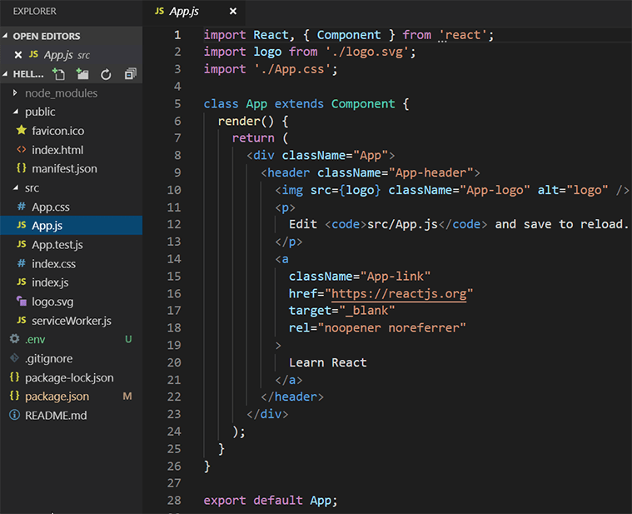
Complete Structure Of A React App

Slide 6
Two Ways to Develop A React App
To overcome this problem the React Team at Facebook has developed a tool called Create React App
CRA is an excellent tool for professional developers, which allows us to create and run our React project very quickly

Slide 7
Two Ways to Develop A React App
It automatically wraps up all of the required dependencies like Webpack, Babel for a React project itself and then we need to focus on writing React code only
But for downloading and using the Create React App tool we first need to install Node.js on our machine.

Slide 8
Difference Between CDN
And Create-React-App
CDN | Create React App
1.) This approach provides a quick and direct path in which you initially spend more time writing code and less time fiddling with your development environment. | 1.) This approach, while a bit complicated and time-consuming at first, is the way modern web development is done these days.
2.) To use this approach, all we do is reference a script file. | 2.) To use this we need to install Node.js on our machine.
3.) It is good environment for beginners or newcomers | 3.) It is a good environment for newcomers toas well as professionals since the CRA-tool itself handles a lot of difficult configuration setup.

Slide 9
Using First Approach
For our introductory look at React, we are going to use the first approach.
We will be building our first React Element and it will be a <h1> tag with the text “React Rocks!!!”

Slide 10
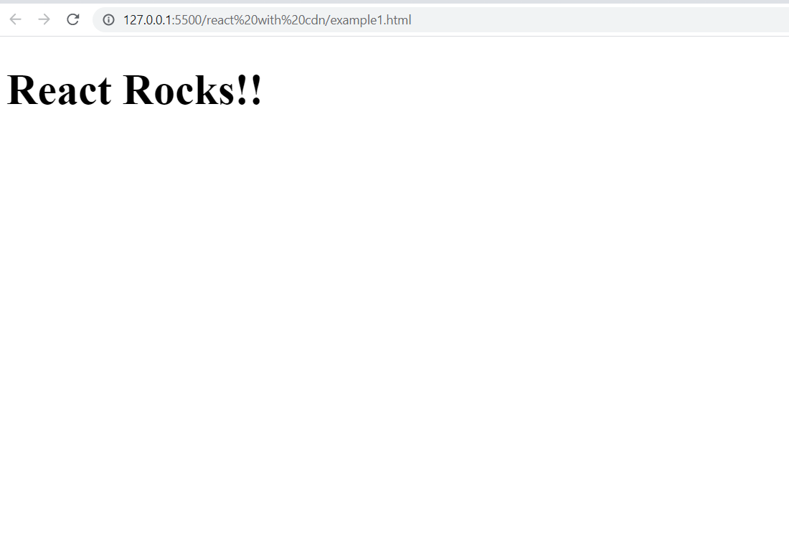
The Desired Output

Slide 11
Using First Approach
In order to achieve this , we have to follow 4 steps:
Create an HTML page with a <div> element.
Add the React libraries to the HTML page using CDN links
Call the method React.createElement() and create an <h1> element
Call the method ReactDOM.render() to render the heading element to the page

Slide 12
Step-1:Creating The HTML Page
Create a new HTML document with the following contents:
<!DOCTYPE html>
<html lang="en">
<head>
<title>Using React With CDN</title>
</head>
<body>
<div id="root"></div>
</body>
</html>

Slide 13
Step-2:Adding React CDN Links
The previous page has nothing interesting or exciting going for it, but let’s fix that by adding a reference to the React library.
For doing this , we need to do the following:
Visit the following page at the React website: https://reactjs.org/docs/cdn-links.html
From there copy the <script> tag of react and react-dom CDN links
Make sure you copy the development version , not the production version.
Paste these <script> tags inside the <head> tag of the HTML page

Slide 14
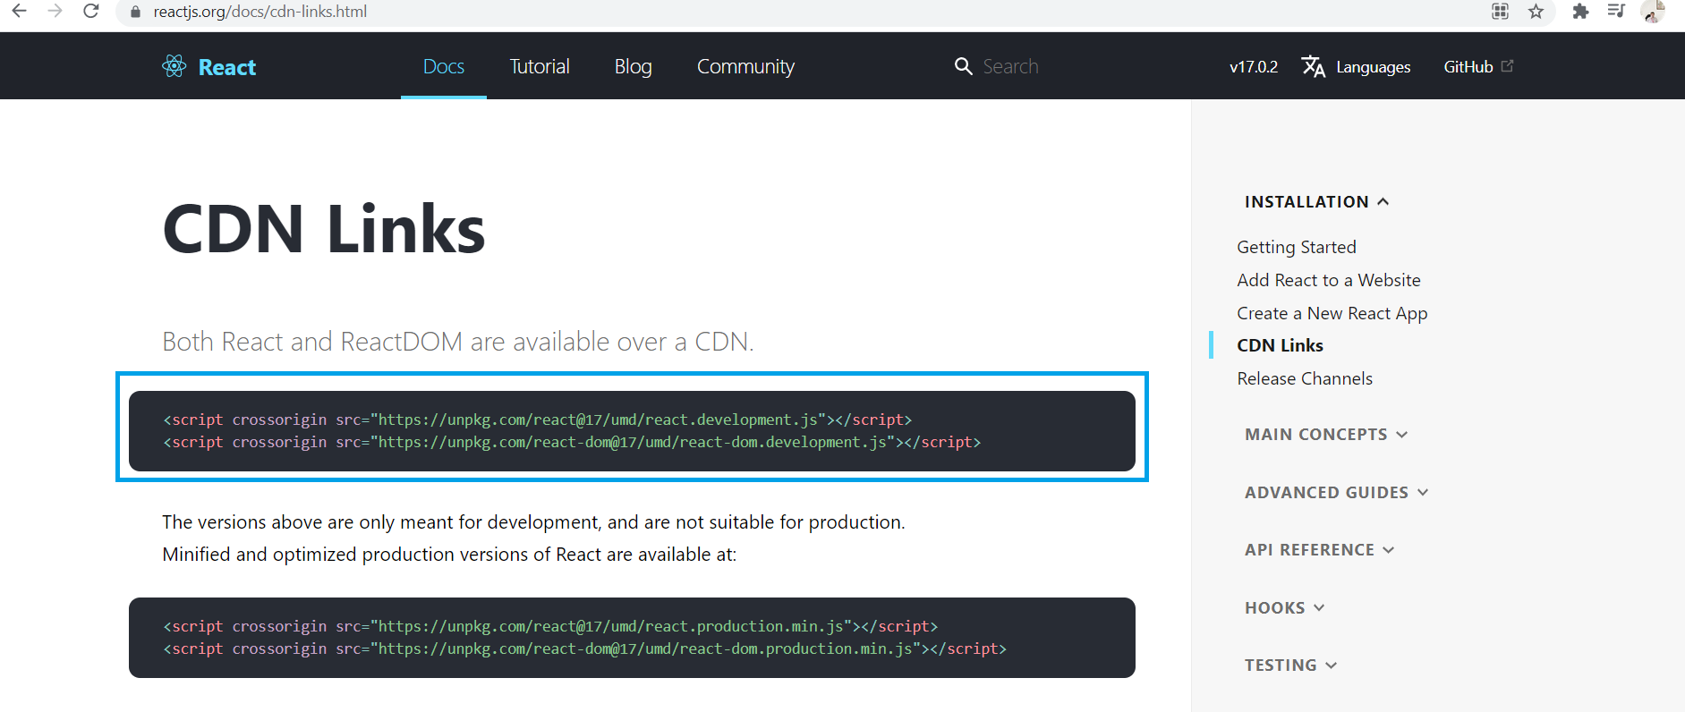
Step-2:Adding React CDN Links
These two lines bring in both the core React library and the various things React needs to work with the DOM. Without them, we aren’t building a React app at all.

Slide 15
Step-2:Adding React CDN Links
At this point, our HTML page should look as follows:
<!DOCTYPE html>
<html lang="en">
<head>
<title>Using React With CDN</title>
<script crossorigin src="https://unpkg.com/react@18/umd/react.development.js">
</script>
<script crossorigin
src="https://unpkg.com/react-dom@18/umd/react-dom.development.js">
</script>
</head>
<body>
<div id="root"></div>
</body>
</html>

Slide 16
Step-3:Calling React.createElement()
Now we’re going to use React to create a React element for <h1> with the text React Rocks!! to be displayed on the page.
To do this we have to call a method called createElement() which belongs to React object.

Slide 17
Step-3:Calling React.createElement()
The createElement() method has the following syntax:
React.createElement(type, props, [...children])
As we can observe this method takes 3 arguments:
type: can be either a tag name string (such as 'div' or 'span'), a React component type (a class or a function), or a React fragment type.
props: It can be a Java Script object containing HTML attributes for the element or null
children: whatever we want to put inside the newly created element
It will finally create and return a new React element of the given type

Slide 18
What Is A React Element ?
The React Elements that React.createElement() returns are just Plain Old JavaScript Objects that describe the DOM nodes that we would like ReactDOM.render() to create.
They’re not DOM nodes, and not added to the document.
They’re just objects.

Slide 19
Step-3:Calling React.createElement()
To call the createElement() method we need to add the following code in a <script> tag just before the closing <body> tag
<script>
let myElement = React.createElement("h1", null, "React Rocks!!");
</script>

Slide 20
Complete Code Till Step -3
<!DOCTYPE html>
<html lang="en">
<head>
<title>Using React With CDN</title>
<script crossorigin src="https://unpkg.com/react@18/umd/react.development.js">
</script>
<script crossorigin
src="https://unpkg.com/react-dom@18/umd/react-dom.development.js">
</script>
</head>
<body>
<div id="root"></div>
<script>
let myElement = React.createElement("h1", null, "React Rocks!!");
</script>
</body>
</html>

Slide 21
Step-4:Calling ReactDOM.render()
Once we have created a React element , the next task is to render it on the page .
This is done by calling the ReactDOM object’s method called render().

Slide 22
Step-4:Calling ReactDOM.render()
It has the following syntax:
ReactDOM.render(element,container,[callback])
As we can observe this method takes 3 arguments:
element: The React element to be rendered.
container: The parent node in which the new element is to be rendered
callback: The optional callback to be executed after the element has been rendered
It will finally return a reference to the component that we have created

Slide 23
Step-4:Calling ReactDOM.render()
To call the render() method we need to add the following code in the <script> tag
<script>
let myElement = React.createElement("h1", null, "React Rocks!!");
let mydiv = document.querySelector("#root");
ReactDOM.render(myElement, mydiv);
</script>

Slide 24
The Final Code
<!DOCTYPE html>
<html lang="en">
<head>
<title>Using React With CDN</title>
<script crossorigin src="https://unpkg.com/react@18/umd/react.development.js">
</script>
<script crossorigin
src="https://unpkg.com/react-dom@18/umd/react-dom.development.js">
</script>
</head>
<body>
<div id="root"></div>
<script>
let myElement = React.createElement("h1", null, "React Rocks!!");
let mydiv = document.querySelector("#root");
ReactDOM.render(myElement, mydiv);
</script>
</body>
</html>

Slide 25
Final Output

